Slide 1
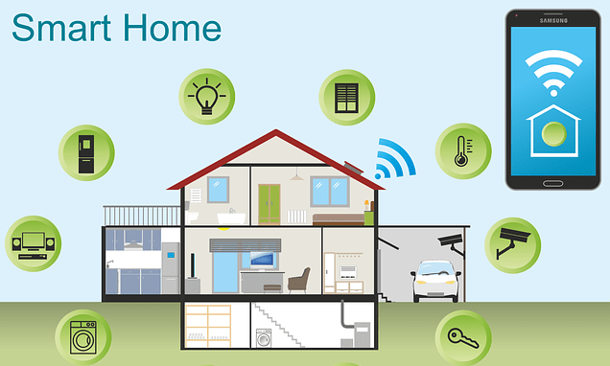
Team Noobcoder
Muhammad Amirul Hakimi Bin Zaprunnizam Muhammad Iqbal bin Mohd Fauzi Muhammad Amjad Bin Abdul Malik Patrick Stephen Muhammad Farid Izwan Bin Mohamad Shabri

Slide 2

WHAT IS A SMART HOME?
Smart home refers to a convenient home setup where appliances and devices can be automatically controlled remotely from anywhere with an internet connection using a mobile or other networked device. Devices in a smart home are interconnected through the internet, allowing the user to control functions such as security access to the home, temperature, lighting, and a home theater remotely[1].

Slide 3
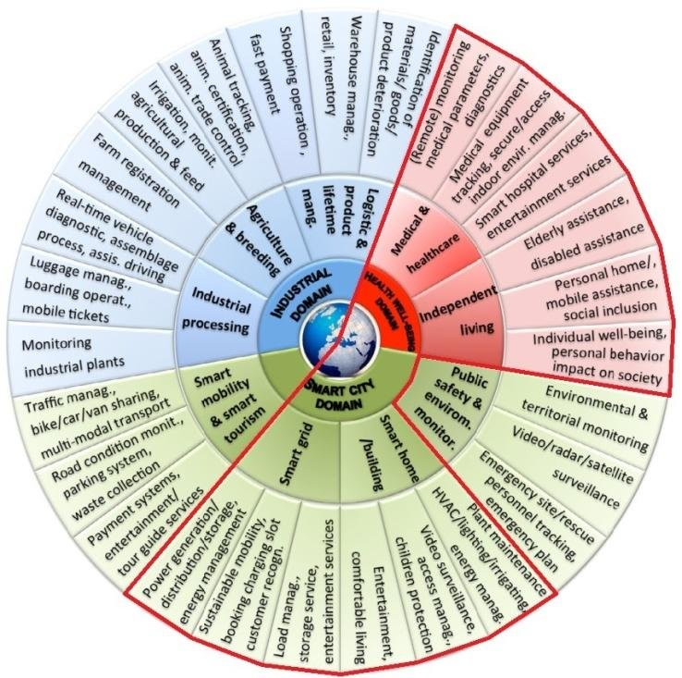
APPLICATION DOMAIN

Slide 4
APPLICATION DOMAIN
Domain of building automation system is more complex and depending on type of buildings. Different systems can be applied on different buildings :
Lighting system
Solar Radiation Protection System
Sun blinds
Air-conditioning system
Heating System
Sanitary facilities
Lift facilities
Telecommunication system
Safety system

Slide 5
2. Technologies Used In Connected Home
RFID – Radio Frequency Identification: RFID technology using wireless RF bi-directional transmission of data between the reader and tag, has reached the target identification and the purpose of data exchange. The most basic RFID system consists of three parts: the electronic tags (Tag), the reader (Reader) and pass the RF signal between the tag and the reader miniature antenna.[2]
IP – Internet Protocol: Wi-Fi is the fast and reliable wireless communication, with a range of around 25m.Zigbee is a wireless protocol which operates in a mesh network and uses a device to relay a signal to other devices, strengthening and expanding the network. Z-Waveis similar to Zigbee and this is an open source mesh network protocol. The main difference between the two is the data throughput — Z-wave is roughly 6 times slower than Zigbee.
WSN – Wireless Sensor Networks: Wireless Sensor Networks (WSNs) provide several types of applications providing comfortable and smart-economic life. Communication can be performed using three main access technology architectures: IEEE 802.15.3 and 802.15.4 for Wireless Personal Area Network (WPAN), IEEE 802.11g and 802.11 for Wireless Local Area Network (WLAN), and High Speed Downlink Packet Access (HSDPA) and Long-Term Evolution (LTE) for Wireless Wide Area Network (WWAN) [3].

Slide 6
Architecture Of Connected Home
Smartphone Centric Architecture (with or without cloud): Using this technology, a light bulb is connected directly to a smartphone via Bluetooth. Thus, the light bulb does not have a direct link to the Internet and depends on the proximity of the smartphone.
Hub-Centric Architecture (with or without cloud): It is working as an intermediary for connecting a bulb to the smartphone and to the Internet, since it usually connects to the home Wi-Fi or Ethernet network.
Cloud Centric Architecture (without hub): This is a smart device that is directly connected to the home Wi-Fi network and does not need any additional hub to work. It has a simple setup process for the customer and looks similar to the Smartphone Centric Architecture but with the benefit of a direct and constant connection of the device to the Internet.

Slide 7
MAIN ELEMENTS IN SMART HOME
Although the possibilities are endless when it comes to smart technology and home automation, every smart home is composed of one or more of the 5 elements:
Energy
Security
Atmosphere
Convenience
Entertainment
These elements represent the areas of our homes and our lives that can benefit from smarter technology. The perfect smart home incorporates and seamlessly integrates all 5 elements.

Slide 8
5 Elements of Smart Home
Energy = Smart homes should help us save money by being energy efficient. They should learn the usage of energy pattern and anticipate our needs.
Security = Smart homes should monitor things 24/7, so we don't have to. They should recognize any insecurities that happen and notify us, so that we can review it any time.
Convenience = Smart homes should ease our access on the things we want to control. Save more time and enjoyable.
Atmosphere = Smart homes should provide a good environment and recognize what the users like or not.
Entertainment = Smart homes should be entertaining for user to have leisure time at home.

Slide 9

HOME AUTOMATION SYSTEM
made up of three elements or so-called components:
a hub
a connected application
a smart device

Slide 10
A SMART HUB
The hub is the command center of the smart home ecosystem. It’s the piece that connects individual devices and helps them talk to one another. Some systems have hubs that work only with devices from the same manufacturer, while others—like the Amazon Echo—work with myriad pieces.

Slide 11
A CONNECTED APPLICATION
An app or a connected mobile app is what gives you the ability to control or monitor your smart devices remotely. You simply download the system’s companion app and pair it with your hub, and you’re done. While each product’s app works a bit differently, they generally provide power controls, timer access, and more.

Slide 12
A SMART DEVICE
Smart devices implement commands. Here are just a few examples of the different types of smart devices you may be able to add to a system:
Access Control and Security Gadgets: Access control and security devices include security cameras, smart locks, and motion sensors.
Appliances: Almost any appliance could become a part of your home automation system in the next few years. Smart refrigerators, washing machines, dishwashers, and ovens already exist. Smaller appliances, such as connected coffee pots and slow cookers, have been around for a while, too.
Climate Controls: Climate control services often dovetail with energy management systems. Smart thermostats are the most popular example of climate controllers.
Resource Managers: Smart energy management devices include remote sprinkler controls and energy monitoring devices. Smart switches and strips fall into this category, too.
Entertainment : includes smart TVs, wireless speakers, and film projectors.
Health Care Devices: Health care systems are a growing area in the smart home industry. Smart humidifiers and smart scales are two common examples.
Lighting Controls: Lighting controls require little fanfare. They cover dimmers, light bulbs, light strips, and switches. Many manufacturers live in the lighting space, including GE, Philips, and Belkin.

Slide 13
Our devices
Home Technology
Heating
Light
Ventilation
Windows
Door
Home Appliances
Oven
Fridge
Washing Machine
Consumer Electronic
Video and Audio devices
Communication Equipment
Telephone
Pc
Internet
Electric
Switch
Socket
Powerline

Slide 14
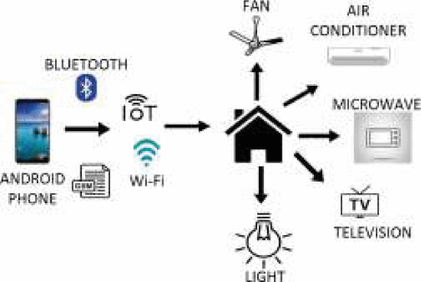
ARCHITECTURAL OVERVIEW
Home Automation System [4]

Slide 15
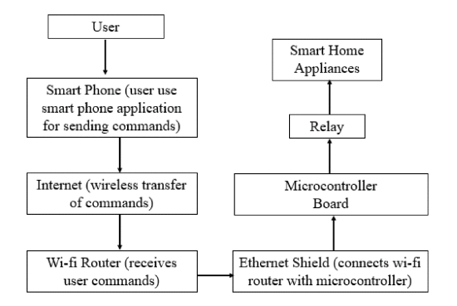
Smart Home System Based on Wi-fi and Internet
Block diagram of Internet and Wi-fi based smart home system.[4]

Slide 16
Advantages
Saving
- The financial saving will get your attention, where the smart home technology can alone save anywhere from 10%-30% money on your energy bills.
Safety
- User can install a security system that allows them to monitor any suspicious activities that occur in and around your home.
Control
- The control at your fingertips is provided by smart home technology. You can use your mobile apps to control the functionality of your home from anywhere in the world now.
Convenience
- It allows user to use the mobile and tables and you’ll be able to tap into enormous functions and appliances throughout the home.
Comfort
- Having smart home technology can just make our lives easy, as it improves the functionality of appliances, thus helping them run better

Slide 17
THANK YOU

Slide 18
References :
[1]Chen, J., 2020. Smart Home. [online] Investopedia. Available at: <https://www.investopedia.com/terms/s/smart-home.asp> [Accessed 22 November 2020].
[2]Miller, M., 2017. My Smart Home For Seniors. Que
[3]Felfernig, A., Hotz, L., Bagley, C. and Tiihonen, J., 2014. Knowledge-Based Configuration. Morgan Kaufmann.
[4] M. Hasan, P. Biswas, M. T. I. Bilash and M. A. Z. Dipto, "Smart Home Systems: Overview and Comparative Analysis," 2018 Fourth International Conference on Research in Computational Intelligence and Communication Networks (ICRCICN), Kolkata, India, 2018, pp. 264-268, doi: 10.1109/ICRCICN.2018.8718722.

